Slide 1









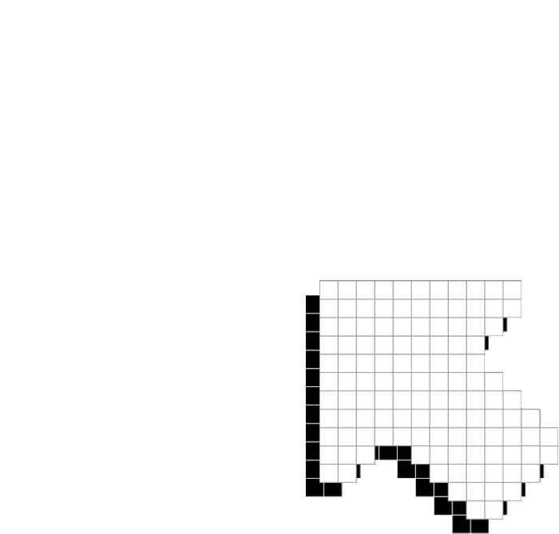




PLAYER 1
HIGHSCORE 2500
PLAYER 2
CAR LANE DETECTION
detect car lane using deep learning methods

Slide 2













01
07
12
INTRO
CAR LANE DETECTOIN: PREVENTS ACCIDENTS
HELPS IN NAVIGATION
Dataset
preprocessing
training and testing
evaluation

Slide 3
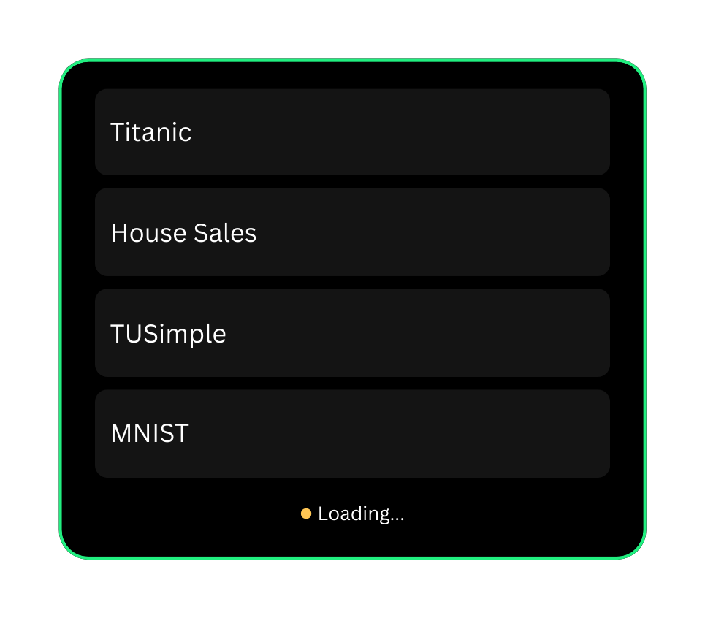



01
07
12
DATASET

Slide 4

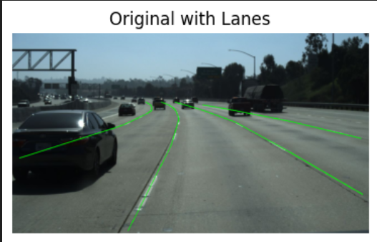

01
07
12

Slide 5
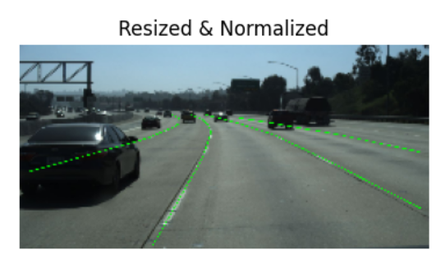
01
07
12
PREPRocessing
Resize the image to (128,256)
Convert to Pytorch Tensor
use Z-normalization
Back to
Agenda Page

Slide 6
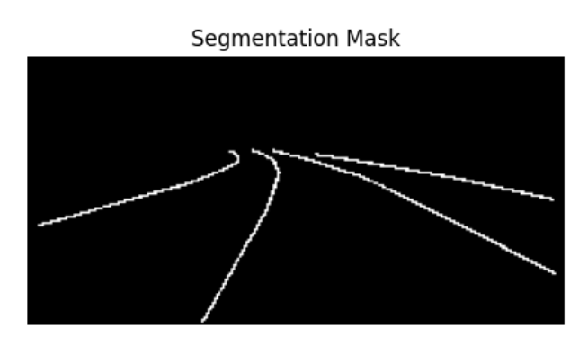
01
07
12
PREPRocessing
Semantic segmentation:
assign a label to each pixel
(1 for lane and 0 for backgrnd)
dataloader improves:
Speed by batching and parallel loading
faster transfer to GPU
shuffles data to avoid overfitting
Back to
Agenda Page

Slide 7









Back to Agenda Page
MODEL
ARCHITECTURES

Slide 8
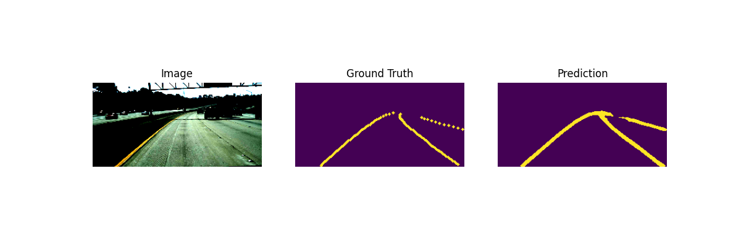
U-Net
The output is a 2-channel map where each pixel is classified as background (0) or lane (1) using CrossEntropyLoss.
Accuracy= 0.944, Loss=0.15
Back to Agenda Page

Slide 9
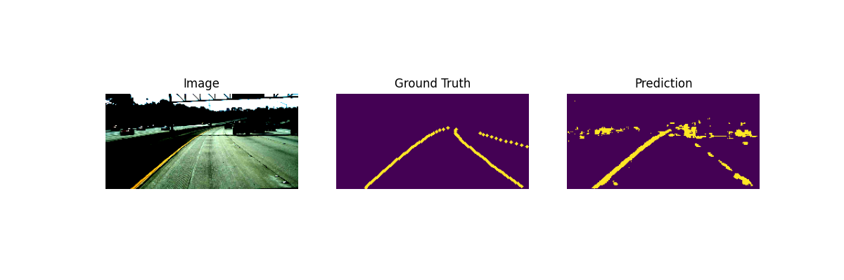
E-Net
Known for real-time performance and low memory usage.
Accuracy= 0.904, Loss=0.388
Back to Agenda Page

Slide 10
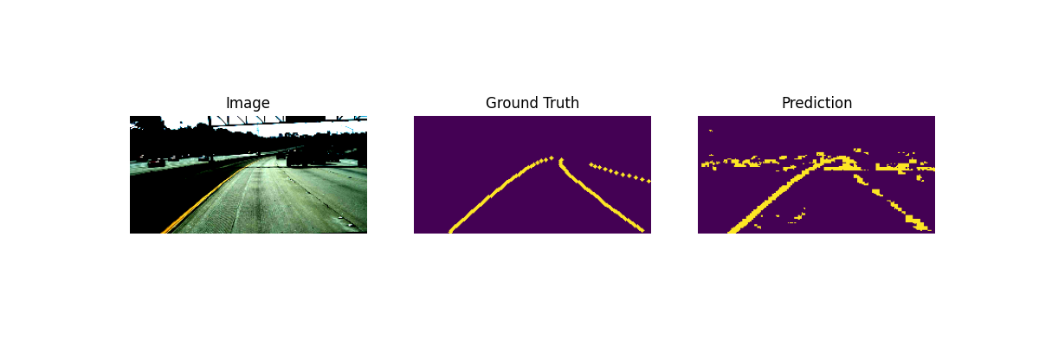
FastSCNN
real-time segmentation model designed for mobile devices.
Accuracy= 0.909, Loss=0.395
Back to Agenda Page

Slide 11
Back to Agenda Page
U-NET IS THE HIGHEST ACCURACY MODEL WITH LOWEST LOSS.

Slide 12
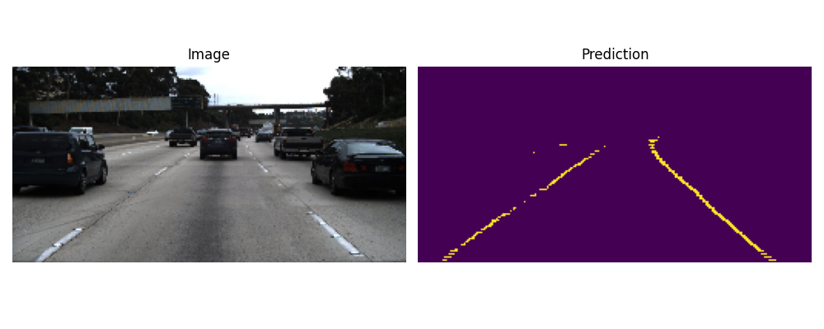
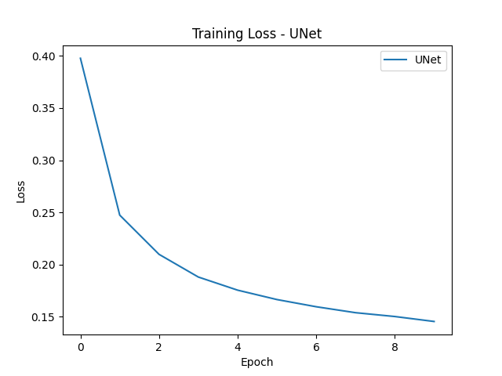

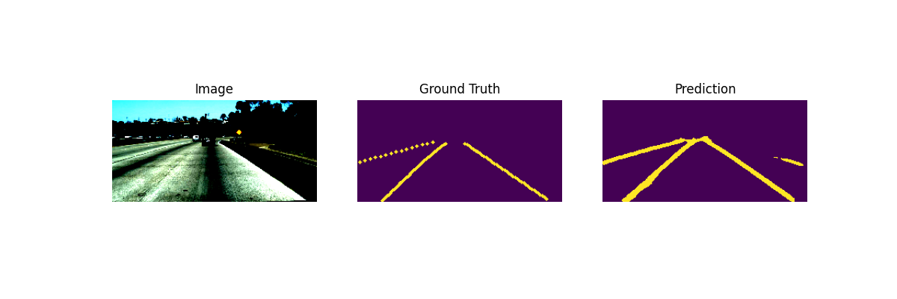
PLAYER 1
Visualizations for UNET
Back to Agenda Page

Slide 13





THANK YOU!
BY: MAYA AHMED ELMOSALAMY
ID: 2022/05000
SUPERVISED BY: DR. ALAA HAMDY

